Slide 1
CPU Scheduling
Course Instructor: Nausheen Shoaib

Slide 2
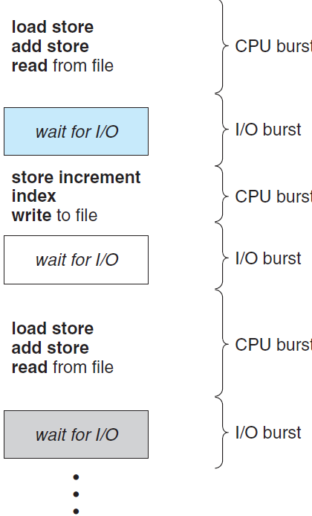
Basic Concepts
Maximum CPU utilization obtained with multiprogramming
CPU–I/O Burst Cycle – Process execution consists of a cycle of CPU execution and I/O wait
CPU burst followed by I/O burst
CPU burst distribution is of main concern

Slide 3
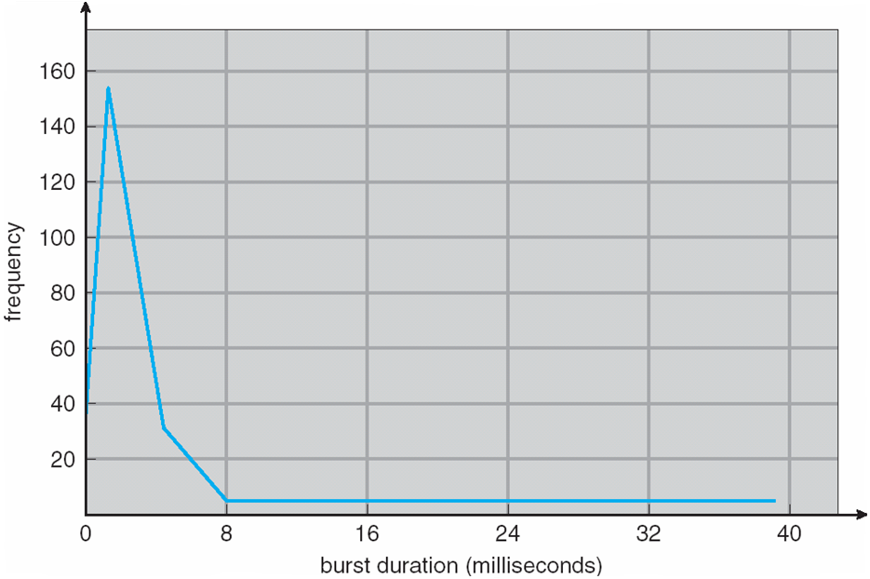
Histogram of CPU-burst Times

Slide 4
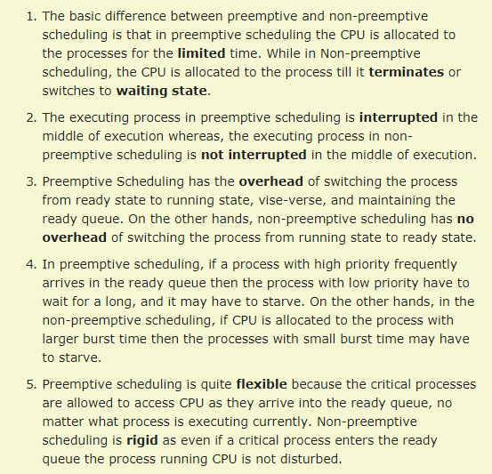
Preemptive Vs. Non Preemptive Scheduling

Slide 5
Dispatcher
Dispatcher module gives control of the CPU to the process selected by the short-term scheduler; this involves:
switching context
switching to user mode
jumping to the proper location in the user program to restart that program
Dispatch latency – time it takes for the dispatcher to stop one process and start another running

Slide 6
Scheduling Criteria
CPU utilization – keep the CPU as busy as possible
Throughput – # of processes that complete their execution per time unit
Turnaround time – amount of time to execute a particular process
Turnaround time (TAT)=Completion time – Arrival time
Waiting time – amount of time a process has been waiting in the ready queue
Response time – amount of time it takes from when a request was submitted until the first response is produced, not output (for time-sharing environment)

Slide 7
Scheduling Algorithm Optimization Criteria
Max CPU utilization
Max throughput
Min turnaround time
Min waiting time
Min response time

Slide 8
First-Come, First-Served (FCFS) Scheduling
Process Burst Time
P₁ 24
P₂ 3
P₃ 3
Suppose that the processes arrive in the order: P₁ , P₂ , P₃
The Gantt Chart for the schedule is:
P₁
P₂
P₃
0
24
27
30

Slide 9
Example FCFS
Covered in class

Slide 10
FCFS Scheduling (Cont.)
Suppose that the processes arrive in the order:
P₂ , P₃ , P₁
The Gantt chart for the schedule is:
Waiting time for P₁ = 6; P₂ = 0; P₃ = 3
Average waiting time: (6 + 0 + 3)/3 = 3
Much better than previous case
Convoy effect - short process behind long process
Consider one CPU-bound and many I/O-bound processes
P₂
P₃
P₁
0
3
6
30

Slide 11
Shortest-Job-First (SJF) Scheduling
Associate with each process the length of its next CPU burst
Use these lengths to schedule the process with the shortest time
SJF is optimal – gives minimum average waiting time for a given set of processes
The difficulty is knowing the length of the next CPU request
Could ask the user

Slide 12
Example of SJF
ProcessArriva l Time Burst Time
P₁ 0.0 6
P₂ 2.0 8
P₃ 4.0 7
P₄ 5.0 3
SJF scheduling chart
Average waiting time = (3 + 16 + 9 + 0) / 4 = 7
P₄
P₁
P₃
P₂
0
3
9
16
24

Slide 13
Example of SJF
Covered in class

Slide 14

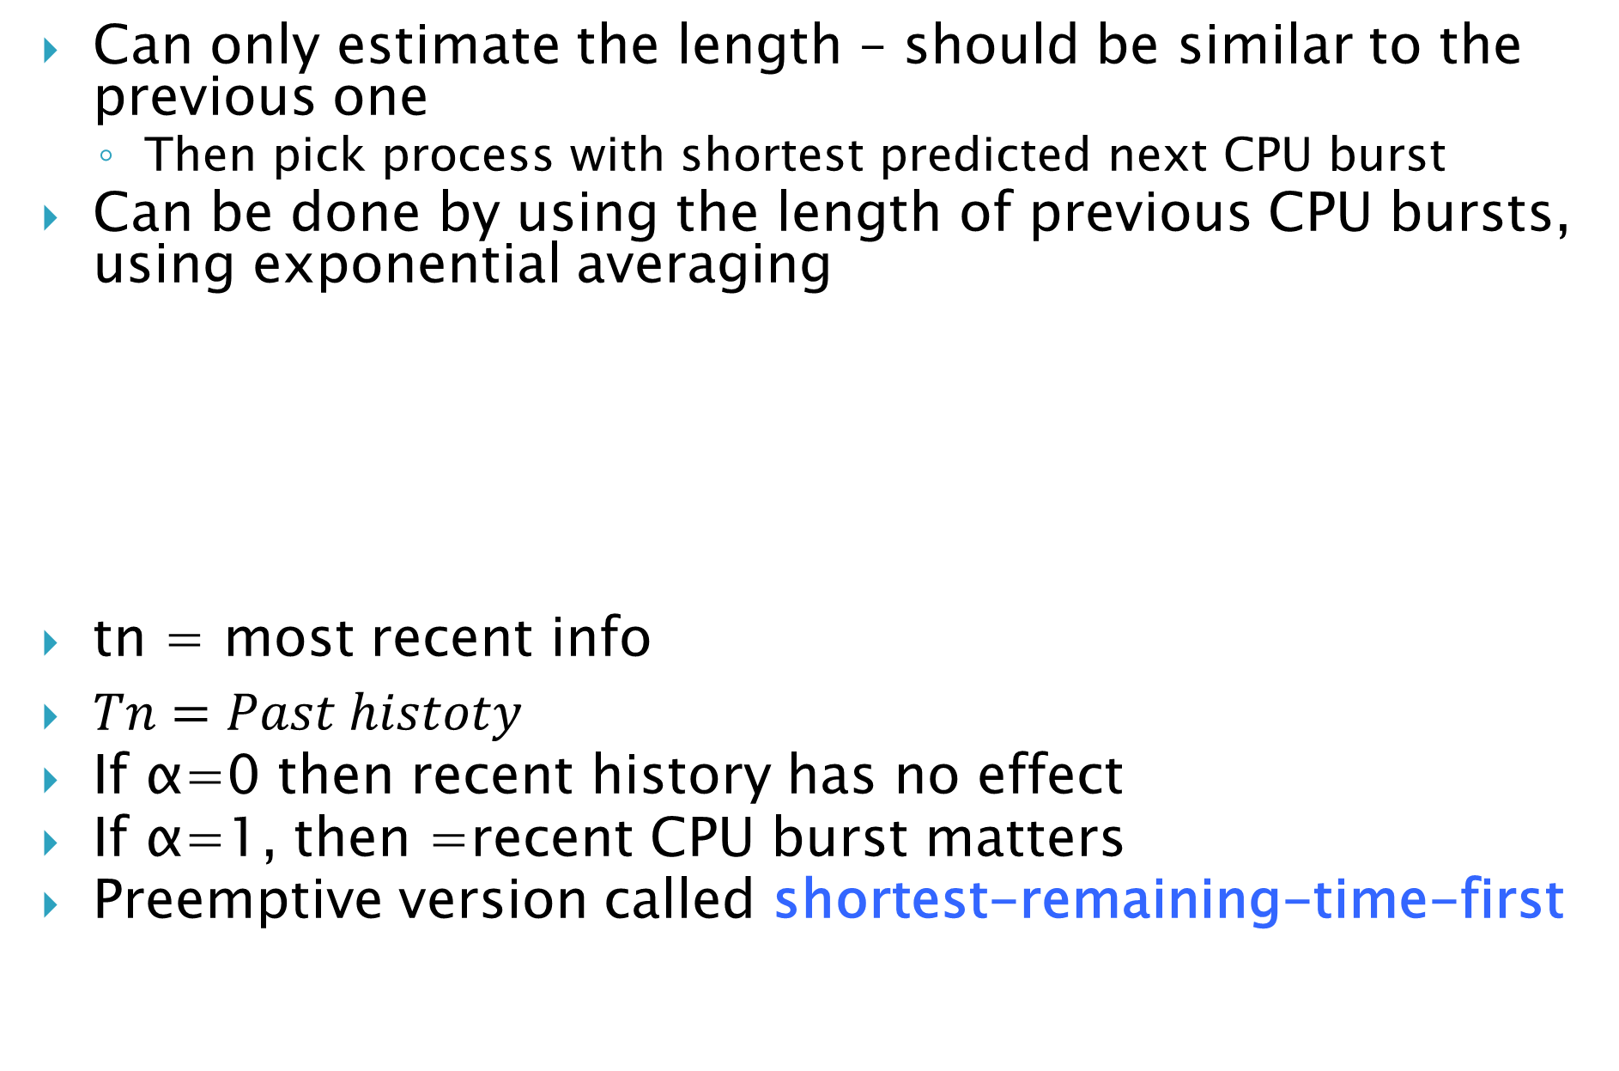
Determining Length of Next CPU Burst
Can only estimate the length – should be similar to the previous one
Then pick process with shortest predicted next CPU burst
Can be done by using the length of previous CPU bursts, using exponential averaging
tn = most recent info
$Tn=Past histoty$
If α=0 then recent history has no effect
If α=1, then =recent CPU burst matters
Preemptive version called shortest-remaining-time-first

Slide 15
Shortest-remaining-time-first
Now we add the concepts of varying arrival times and preemption to the analysis:
the process with the smallest amount of time remaining until completion is selected to execute.

Slide 16
Example of SRTF
Covered in class

Slide 17
Priority Scheduling
A priority number (integer) is associated with each process
The CPU is allocated to the process with the highest priority (smallest integer ≡ highest priority)
Preemptive
Non-preemptive
Problem ≡ Starvation – low priority processes may never execute
Solution ≡ Aging – as time progresses increase the priority of the process

Slide 18
Example of Priority Scheduling
ProcessA arri Burst TimeT Priority
P₁ 10 3
P₂ 1 1
P₃ 2 4
P₄ 1 5
P₅ 5 2
Priority scheduling Gantt Chart
Average waiting time = 8.2 msec
P₂
P₅
P₁
P₃
P₄
0
1
6
16
18
19

Slide 19
Example Priority
Covered in class

Slide 20
Round Robin (RR)
Each process gets a small unit of CPU time (time quantum q), usually 10-100 milliseconds. After this time has elapsed, the process is preempted and added to the end of the ready queue.
If there are n processes in the ready queue and the time quantum is q, then each process gets 1/n of the CPU time in chunks of at most q time units at once. No process waits more than (n-1)q time units.
Timer interrupts every quantum to schedule next process
Performance
q large ⇒ FIFO
q small ⇒ q must be large with respect to context switch, otherwise overhead is too high

Slide 21
Example of RR with Time Quantum = 4
Process Burst Time
P₁ 24
P₂ 3
P₃ 3
The Gantt chart is:
Completion time = P1=30; P2=7; P3=10
TAT =P1= (30-0); P2=(7-4); P3=(10-7)
Avg. TAT=

Slide 22
Example RR
Covered in class

